Slide 1
Data Visualization
Katelina Boykova
15 October 2015

Slide 2
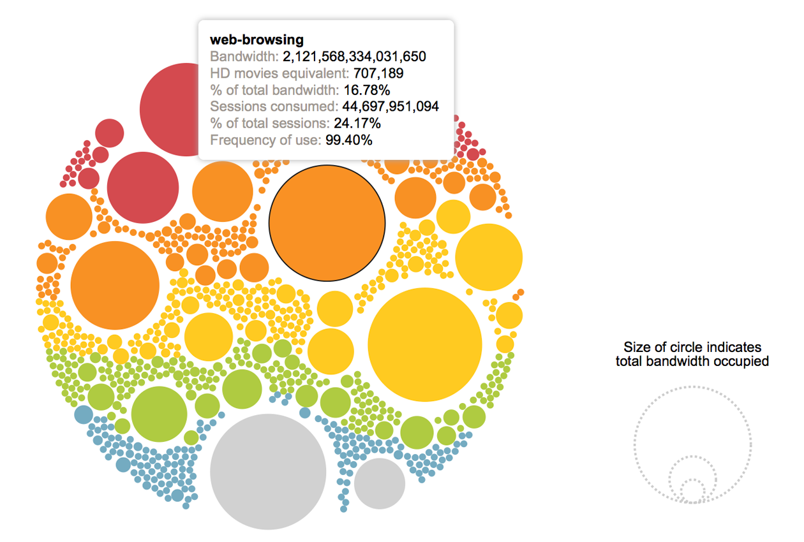
Example: Network traffic

Slide 3
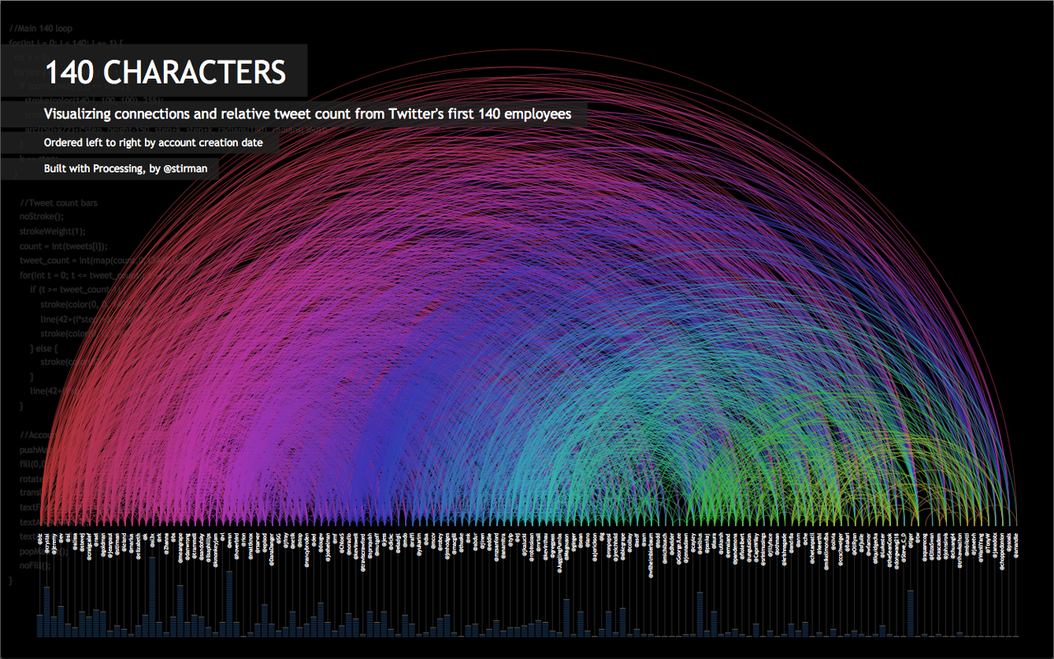
Example: Tweets representation

Slide 4
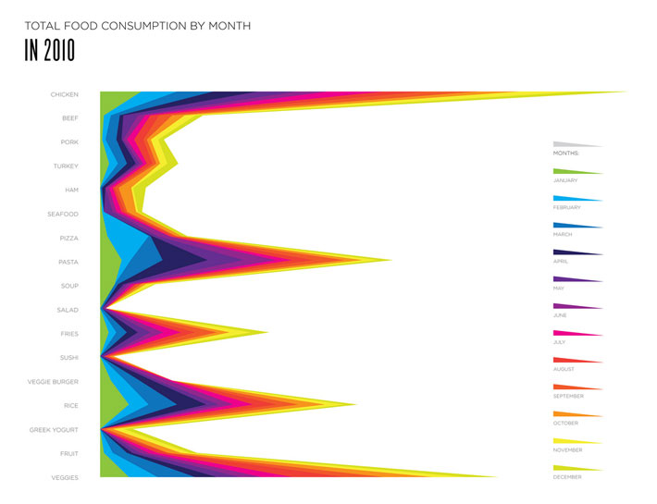
Example: Food consumption

Slide 5
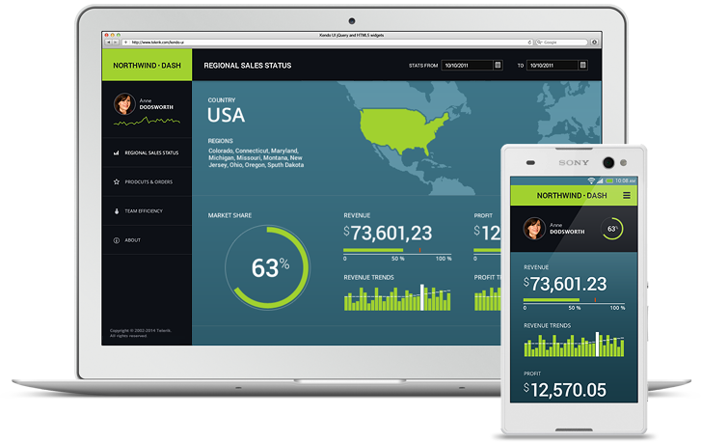
What is Data visualization?
Overview
Data visualization is the presentation of data or information by encoding it as visual objects (e.g., points, lines or bars) contained in graphics.
Goal
To communicate information clearly and effectively, thus to make complex data more accessible, understandable and usable.

Slide 6
Tufte: “Graphics reveal data”
Excellence in statistical graphics consists of complex ideas communicated with clarity, precision and efficiency. Graphical displays should:
show the data
present many numbers in a small space
make large data sets coherent
encourage the eye to compare different pieces of data
reveal the data at several levels of detail, from a broad overview to the fine structure.

Slide 7
Why is data visualization important?
Data visualization help people see things that were not obvious to them before.
Data visualization makes interpretation easier.
Data visualization simplifies the data, instantly clarifying the important KPIs, factors, trends, etc.

Slide 8
Primary types of displaying information
Table
A table contains quantitative data organized into rows and columns with categorical labels. It is primarily used to look up specific values.
Graph
A graph is primarily used to show relationships among data and portrays values encoded as visual objects (e.g., lines, bars, or points). Numerical values are displayed within an area delineated by one or more axes. These axes provide scales (quantitative and categorical) used to label and assign values to the visual objects. Many graphs are also referred to as charts.

Slide 9
The power of visual perception
2014 Sales revenue
 | Jan | Feb | Mar | Apr | May | Jun | Jul | Aug | Sep | Oct | Nov | Dec
Domestic | $1,983 | $2,343 | $2,593 | $2,283 | $2,574 | $2,838 | $2,382 | $2,634 | $2,938 | $2,739 | $2,983 | $3,493
International | $574 | $636 | $673 | $593 | $644 | $679 | $593 | $139 | $599 | $583 | $602 | $690
 | $2,557 | $2,979 | $3,266 | $2,876 | $3,218 | $3,517 | $2,975 | $2,773 | $3,537 | $3,322 | $3,585 | $4,183
Shows precise values
Shows individual values
No trends, exceptions, relationships, or patterns

Slide 10
The power of visual perception
Domestic sales were much higher
Domestic sales trended upward
August was an exception
Domestic sales exhibited a monthly pattern – up, up, down (“hockey stick”)
USD
(thousands)
Domestic
International

Slide 11
Thinking with our eyes
Seeing and thinking collaborate closely to make sense of the world.
The human visual system is a pattern seeker. When data is presented in certain ways, the patterns can be easily seen.
To use visualization effectively, it takes more than simply displaying data graphically. We must understand how visual perception works.

Slide 12
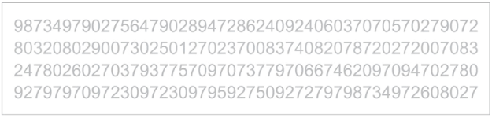
Pre-attentive attributes
A human can distinguish differences in line length, shape orientation, and color (hue) readily without significant processing effort.

Slide 13
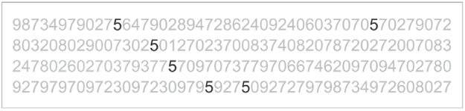
Pre-attentive attributes
A human can distinguish differences in line length, shape orientation, and color (hue) readily without significant processing effort.

Slide 14
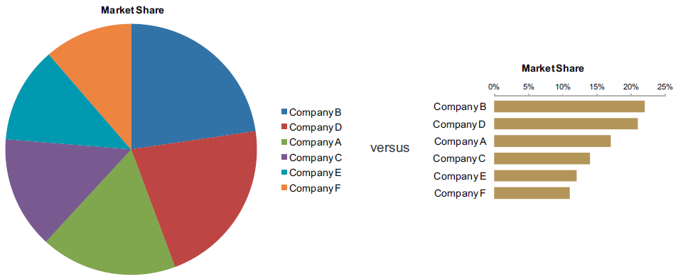
Pre-attentive attributes
Effective graphics take advantage of pre-attentive processing and attributes and the relative strength of these attributes.

Slide 15
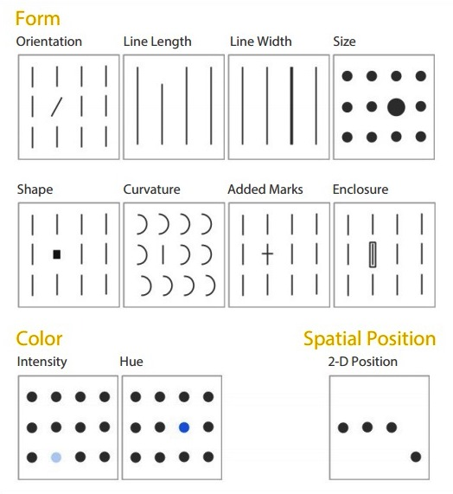
Pre-attentive attributes used in visual displays of data
Each of these pre-attentive attributes can be used for one or more information visualization purposes.

Slide 16
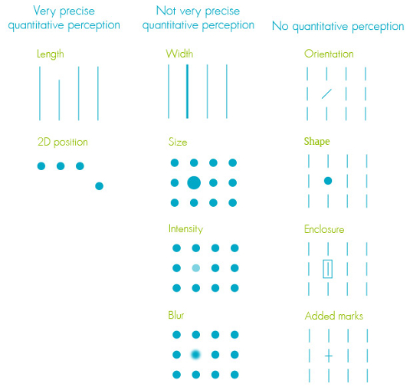
Pre-attentive attributes used in visual displays of data
Some of these pre-attentive attributes are perceptually stronger than others.
Some of these pre-attentive attributes can be perceived quantitatively and can therefore be used to encode numeric values.
Color intensity (grayscale for example) can be quantitatively perceived to a degree, showing that one value is greater than another.
An object's size in 2-D area (simultaneous perception of both length and width) can be perceived quantitatively, in that we can tell that one object is bigger than another. However, it's difficult to determine by how much they differ.

Slide 17

Decision time
“
There is virtually unlimited freedom in how we represent data. The difficult question is how best to represent it."
William Wright

Slide 18
How to design the best visual for my data?
Understand the data you are trying to visualize, and its size.
Determine what you are trying to visualize and what kind of information you want to communicate.
Know your audience and understand how it processes visual information.
Use a visual that conveys the information in the best and simplest form for your audience.

Slide 19
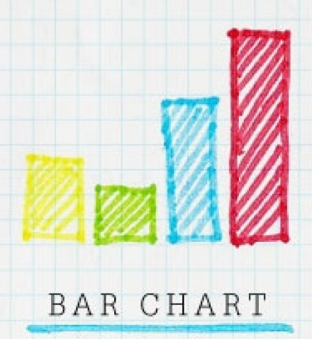
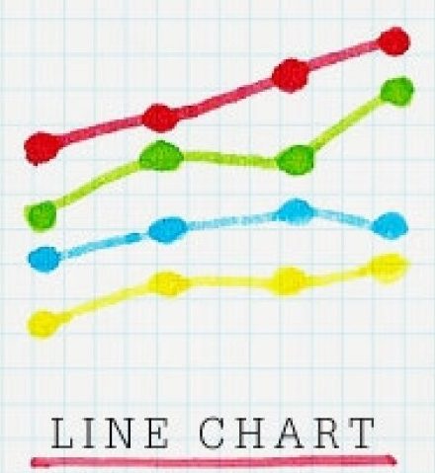
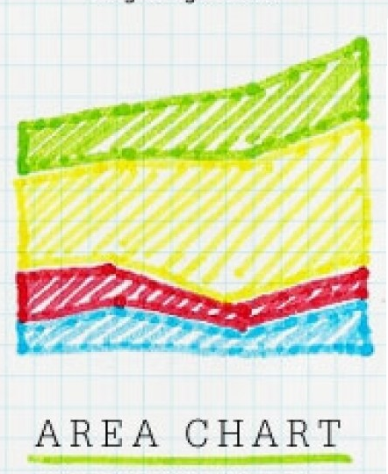
Types of charts
Presents data with rectangular bars with lengths proportional to the values that they represent.
Bar charts provide a visual presentation of categorical data. Grouped bar charts and stacked bar charts can also be used for more complex comparisons of data.
Displays information as a series of data points called 'markers' connected by straight line segments.
A line chart is often used to visualize a trend in data over intervals of time.
Displays graphically quantitative data. It is based on the line chart.
Area charts are used to represent cumulated totals using numbers or percentages (stacked area charts in this case) over time. Can be used for showing trends over time among related attributes.

Slide 20
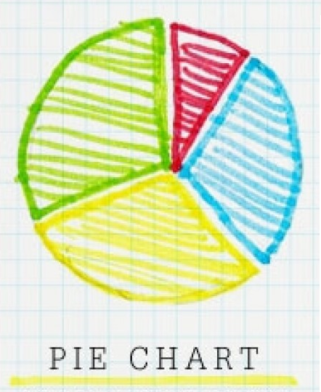
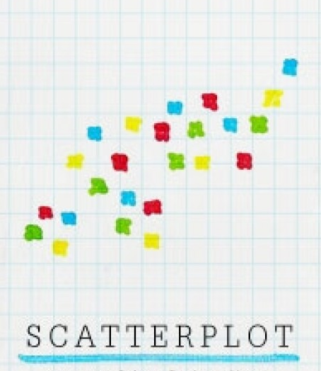
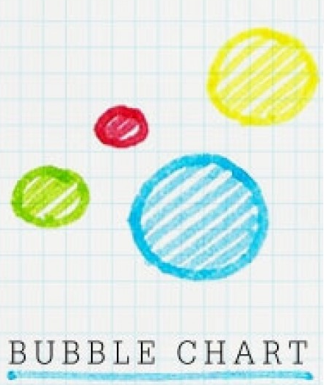
Types of charts
A circular statistical graphic, which is divided into slices to illustrate numerical proportion. In a pie chart, the arc length of each slice (and consequently its central angle and area), is proportional to the quantity it represents.
Displays a collection of points, each having the value of one variable determining the position on the horizontal axis and the value of the other variable determining the position on the vertical axis.
Scatter plot can be used either when one continuous variable that is under the control of the experimenter and the other depends on it or when both continuous variables are independent.
Displays three dimensions of data (the third through its size). Bubble charts can be considered a variation of the scatter plot, in which the data points are replaced with bubbles.
Bubble charts can facilitate the understanding of social, economical, medical, and other scientific relationships.

Slide 21
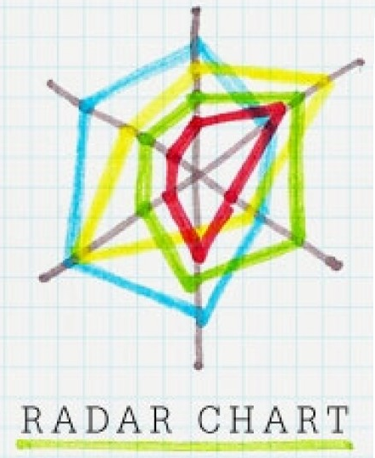
Types of charts
Displays multivariate data in the form of a two-dimensional chart of three or more quantitative variables represented on axes starting from the same point.
Radar charts are a useful way to display multivariate observations with an arbitrary number of variables. Each star represents a single observation. They are also used in sports to chart players' strengths and weaknesses, where they are usually called spider charts.
Polar chart
Range chart
Stock series (Candlestick and OHLC)
…

Slide 22
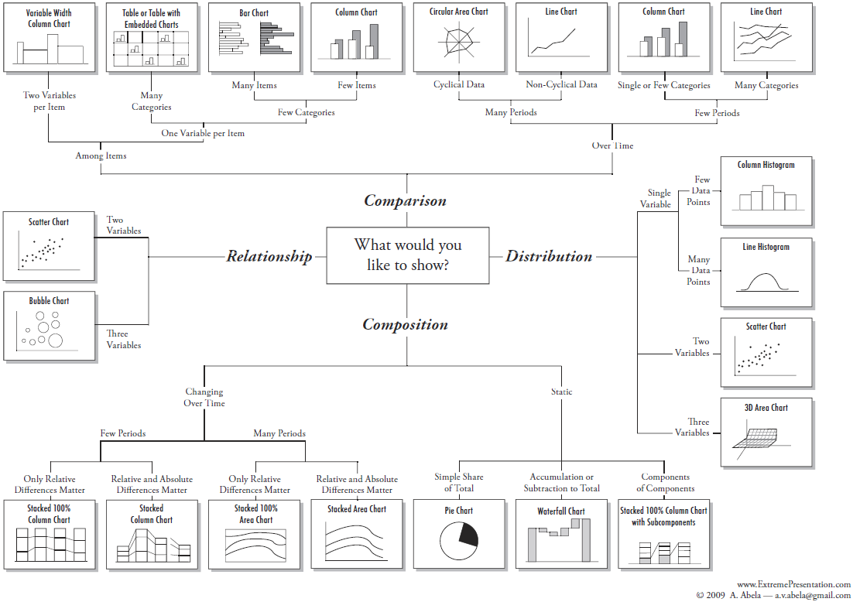
How to design the best visual for my data?

Slide 23
Wrong or Right?
USD
(millions)
USD
(millions)

Slide 24
Wrong or Right?
USD
(millions)
USD
(millions)

Slide 25
Wrong or Right?
USD
(millions)
USD
(millions)

Slide 26
Wrong or Right?
USD
(millions)
USD
(millions)

Slide 27
Wrong or Right?
USD
(millions)
USD
(millions)

Slide 28
Wrong or Right?
USD
(millions)
USD
(millions)

Slide 29

Building blocks of Information Visualization
“
Information visualization is all about gaining understanding, so we can make good decisions.”
Visual Patterns, Trends,
and Exceptions
Information Visualization
Quantitative Relationships
Quantitative Comparisons
Quantitative Reasoning
Visual properties
Visual objects
Stephen Few
Visual Perception

Slide 30
Data visualization is both an art and a science.
See numbers clearly.

Slide 31

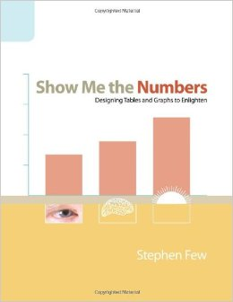
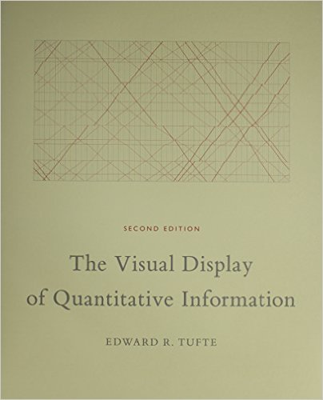
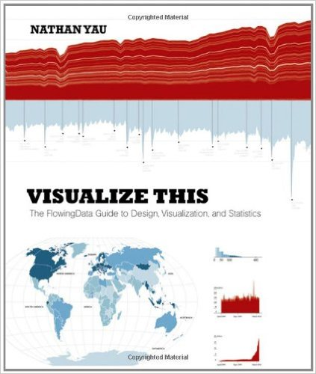
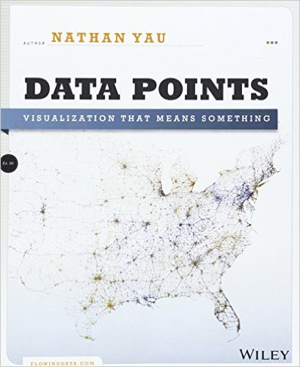
Books

Slide 32
Useful links
www.theguardian.com/data
www.businessinsider.com/category/chart-of-the-day
flowingdata.com
www.informationisbeautiful.net
junkcharts.typepad.com/junk_charts

Slide 33
Thank you.

